Slide 1
Introduction to the CDIO approach Engineering Education for the 21st century
Professor Johan Malmqvist Chalmers University of Technology Gothenburg, Sweden
Notes:
Our graduates need to understand the entire life-cycle of a product. Too often our educational programs tend to focus on design-build, … or design, … or even more limited to just the analysis part of design. Our graduates go out into the work force thinking their jobs will be to just solve more problems and that the answer to the problem is the objective. We need to change the way they view engineering by changing the way we teach engineering.

Slide 2
CHALLENGES AND OPPORTUNITIES FOR ENGINEERING EDUCATION
Multi-disciplinary problems
Design & Innovation
Prior knowledge
Globaliz-ation
Communication & teamwork
New technologies & services
Faculty competence & time
Sustain- able solutions
Personal skills
Entre-preneurship
Digital tools and learning
Remarkable similarity across the world!
Opportunity: Through use of pedagogical innovation and worldwide collaboration, educate engineers who can develop a better future

Slide 3
OUTLINE
Current challenges for engineering education
What is an engineer? What is the professional context of engineering?
The need for a new approach
The CDIO goals and vision
What do engineering graduates need to be able to do?
How can we do better at educating them?
Concluding remarks & discussion

Slide 4
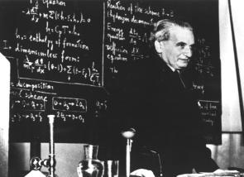
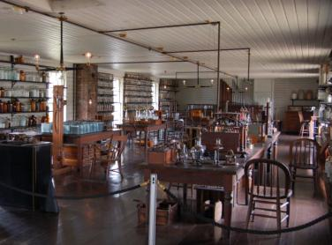
WHAT DO ENGINEERS DO?
”Scientists investigate that which already is. Engineers create that which has never been. - Theodore von Karmann
”What you need to invent, is an imagination and a pile of junk” - Thomas Edison

Slide 5
TO SUMMARIZE: THE MAIN GOALS OF ENGINEERING EDUCATION
To educate students who are able to:
Master a deeper working knowledge of the technical fundamentals
Lead in the creation and operation of new products, processes, and systems
Understand the importance and strategic impact of research and technological development on society
Notes:
The next three slides offer an alternative to the information transfer model of education -- experiential learning. This approach to learning will be explored in Session 3.
Refer to “Rethinking Engineering Education”, pp. 20 - 22. This is a key slide. Be sure participants understand the CDIO goals. Focus on the first two; the CDIO approach tells us how to achieve these goals.
Engineering education should always emphasize the technical fundamentals. Nothing in the CDIO approach is meant to diminish the importance of the fundamentals or students’ need to learn them. Deep working knowledge and conceptual understanding are emphasized to strengthen the learning of technical fundamentals.
This goal recognizes the need to prepare students for engineering.
This goal recognizes that some students will not become practicing engineers, but will pursue careers as researchers in industry, government, and higher education. Despite different career interests, all students benefit from an education set in the context of product, process, and system development.

Slide 6
EVOLUTION OF ENGINEERING EDUCATION
Innovation, Implementation, Collaboration skills Practice
Pre-1950s: Practice
1960s: Science & practice
2000: CDIO
1980s: Science
Analytical skills Disciplinary knowledge Theory
We are not where we want to be – engineering education needs reform!
Notes:
It is important to note, this is not an either/or situation. Within the CDIO context, we can do both. We don’t need to sacrifice deeper disciplinary knowledge for gains in the personal, interpersonal, and systems level skills.

Slide 7
THE PROFESSIONAL ROLE(S) OF ENGINEERS
”Engineers Conceive, Design, Implement and Operate complex products and systems in a modern team-based engineering environment”

Slide 8
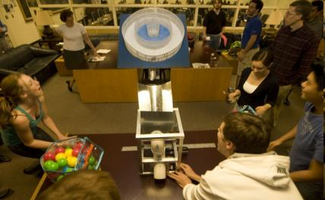
THE C-D-I-O PROCESS
Lifecycle of a product, process, project, system, software, material
Conceive: customer needs, technology, enterprise strategy, regulations; and conceptual, technical, and business plans
Design: plans, drawings, and algorithms that describe what will be implemented
Implement: transformation of the design into the product, process, or system, including manufacturing, coding, testing and validation
Operate: the implemented product or process delivering the intended value, including maintaining, evolving and retiring the system
Duke University

Slide 9
VISION FOR A CDIO-BASED EDUCATION
An education that stresses the fundamentals, set in the context of Conceiving – Designing – Implementing – Operating systems and products:
A curriculum organised around mutually supporting courses, but with CDIO activities highly interwoven
Rich with student design-build projects
Integrating learning of professional skills such as teamwork and communication
Featuring active and experiential learning
Constantly improved through quality assurance process with higher aims than accreditation
Notes:
This leads to the organization of the CDIO Themes:
Curriculum
Design-Build
Teaching and Learning
Assessment

Slide 10
What is the full set of knowledge, skills and attitudes that a student should possess as they graduate from university?
At what level of proficiency?
In addition to the traditional engineering disciplinary knowledge

Slide 11
FROM UNDERLYING NEED TO PROGRAM LEARNING OUTCOMES
Educate students who:
Understand how to conceive- design-implement-operate
Complex products and systems
In a modern team-based engineering environment
And are mature and thoughtful individuals
Process
Product
4. CDIO
Disciplinary
knowledge
2. Personal
3. Inter-
personal
Team
Self
The CDIO Syllabus - a comprehensive statement of detailed goals for an engineering education
Notes:
Translating needs to goals is good engineering practice.
The underlying goals, stated earlier in this session, are translated into four major categories: technical, personal, interpersonal, and the product, process, system lifecycle (CDIO). These four categories will be used to outline the REQUIREMENTS document, that is, the CDIO Syllabus.

Slide 12
THE CDIO SYLLABUS
A generalized list of competences that an engineer should possess
Program specific (1) and general (2-4)
Created and validated by alumni, faculty and students
A ”complete” reference model
1 Disciplinary Knowledge & Reasoning:
1.1 Knowledge of underlying sciences
1.2 Core engineering fundamental knowledge
1.3 Advanced engineering fundamental knowledge
2 Personal and Professional Skills
2.1 Analytical reasoning and problem solving
2.2 Experimentation and knowledge discovery
2.3 System thinking
2.4 Personal skills and attributes
2.5 Professional skills and attributes
3 Interpersonal Skills
3.1 Multi-disciplinary teamwork
3.2 Communications
3.3 Communication in a foreign language
4 CDIO of Complex Systems
4.1 External and societal context
4.2 Enterprise and business context
4.3 Conceiving and engineering systems
4.4 Designing
4.5 Implementing
4.6 Operating
4.7 Engineering Leadership
4.8 Entrepreneurship
CDIO Syllabus contains 2-3 more layers of detail

Slide 13
PRIORITING LEARNING OUTCOMES
5. Innovate
Massachusetts Institute of Technology, Cambridge
4. Skilled
Practice
3. Understand
2. Participate
1. Exposure
Analysis is rated highest but need for almost as high proficiency in design, communication and teamwork
Notes:
These graphs highlight the importance of collecting data to validate program decisions and persuade decision makers.

Slide 14
CO-EVOLUTION OF KNOWLEDGE AND SKILLS
The CDIO strategy is the integrated curriculum where knowledge & skills give each other meaning!
Acquisition of technical knowledge
Development of engineering skills

Slide 15
How can we do better at assuring that students learn these skills?
Within the available student and faculty time, funding and other resources

Slide 16
MORE AND MORE AUTHENTIC DESIGN EXPERIENCES IN THE EDUCATION
Design-build experiences are instructional events in which learning occurs through the creation of a product, process, or system
Provide the natural context in which to teach design, innovation, implementation skills
Provide a platform for training other CDIO syllabus skills (teamwork, communications etc)
Solar- driven aircraft, KTH
Formula Student, Chalmers
Notes:
Point out that design-implement experiences are not restricted to product development. They are equally applicable in engineering disciplines that focus more on processes or systems, e.g., chemical engineering or biological engineering.

Slide 17
THERE SHOULD BE MULTIPLE DESIGN–BUILD PROJECTS IN THE CURRICULUM
Year 1
Year 2
Year 3
Year 4
Mechatronics project course
Joint project in Machine elements & Manuf technology courses
Intro to Mech Eng
Machine
design
Automotive
eng project
Product development
project
Creative, ”conceptual” design
Design for manufacturing
Redesign Multiple objectives
Creative design incl business aspects Cross-dept teams
Simple prototype Qualitative
More advanced prototype Some simulation Company is customer
Prototype as needed More simulation
Prototype Simulation as needed Company is customer

Slide 18
STUDENT WORKSPACES FOR CDIO

Slide 19
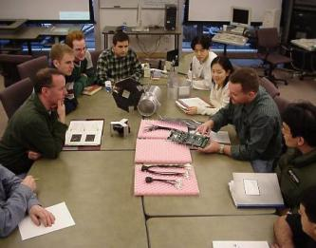
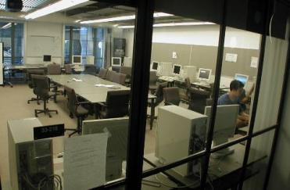
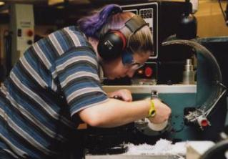
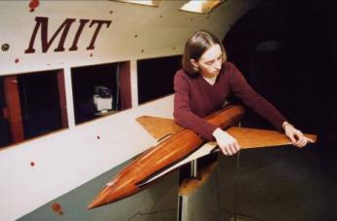
EXAMPLE: MIT AERO-ASTRO DEPARTMENT
Conceive
Design
Implement
Operate

Slide 20
DEVELOP ACTIVE AND EXPERIENTIAL LEARNING ACTIVITIES
Active and experiential learning engages students by setting teaching and learning in contexts that simulate engineering roles and practice
Reformed mathematics emphasizing simulation of realistic engineering problems
Working method based on modeling, simulation & analysis, MATLAB programming
Motivated importance of mathematics and applied mechanics courses
Year 1 lab example

Slide 21
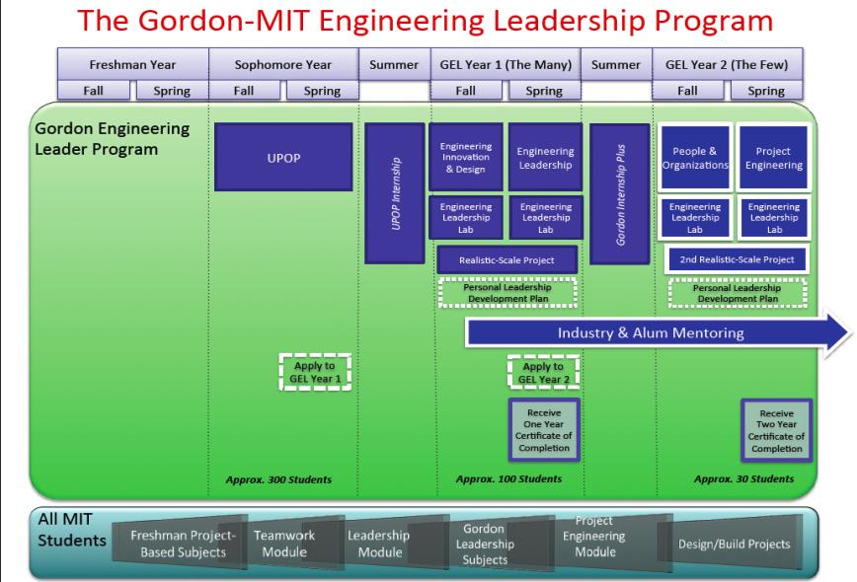
INTEGRATED LEADERSHIP TRAINING

Slide 22
THE 12 CDIO STANDARDS – GUIDELINES FOR EDUCATION DEVELOPMENT

Slide 23
CONCLUDING REMARKS – WHAT IS CDIO
An idea of what engineering students should learn: “Engineers who can engineer”
A methodology for engineering education reform: The CDIO Syllabus and the 12 CDIO Standards
A community: The CDIO Initiative with 107 universities as members
To learn more, visit www.cdio.org or read Rethinking Engineering Education: The CDIO Approach by Crawley, Malmqvist, Östlund & Brodeur, 2007

