Slide 1

Inspiring Innovation. Advancing Research. Enhancing Education.
US Engineering Education
InnovaChile - CORFO
New Engineering for 2030
Plaza San Francisco’s Hotel
March 7, 2014
Norman L. Fortenberry, Sc.D.
Executive Director, ASEE

Slide 2
ASEE
Founded in 1893
Spans all engineering disciplines
Concerned with teaching, research, public service, professional practice, and social awareness
Voice of academic engineering (400 colleges of engineering and engineering technology)
Over 13,000 total individual members
100 corporations, NGOs, governmental agencies

Slide 3
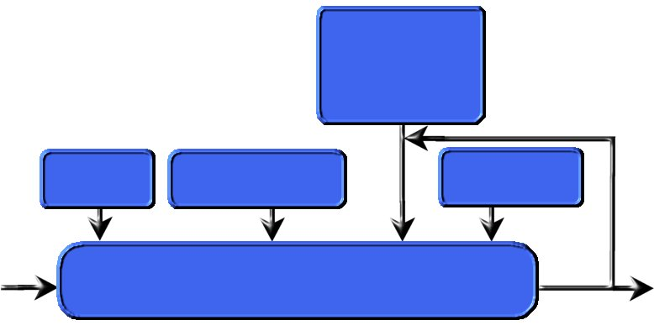
The Engineering Education System
Goals/Objectives:
Depts., Univs.,
Prof. Societies,
Employers, etc.
Teachers&
Learners
Tools (Curriculum
Labs, Tech, etc.)
Constraints and
Ext. Influences
Teaching, Learning & Assessment Processes
Input
Output
Constraints and External Influences:
Social/Cultural/Political/Economic Influences
External Stakeholders (employers, accreditors, funders, etc.)
Inspired by Hubka and Eder (1988)

Slide 4
Goals for Engineering Education
are driven by expectations for engineering:
Economic and social development
Human health, safety, and welfare
Generally meeting human needs and wants through products, processes, and services

Slide 5
Common Global Desires
Flexible engineers better able to straddle uncertainty, disciplines, cultures, evolving technologies, etc.
Engineers as problem definers as well as problem solvers
Engineers prepared for creativity, management, entrepreneurship and public policy leadership
Stronger application skills without losing theoretical strength

Slide 6

The Engineer of 2020
Strong Analytical Skills
Practical Ingenuity
Creativity
Communication Skills
Business and Management Skills
Understand and Practice Leadership
Ethics
Professionalism
Dynamism and Agility
Lifelong Learners
Notes:
The Engineer of 2020 will not be turned into a commodity because she will possess attributes that allow her to adapt and grow over time.

Slide 7
Making the Transition
Traditional Engineer
Problem solver
Excellent mastery of technical skills
Understands technical context of work
Is content doing all her/his work in one country
Reports up the management chain to MBA
Modern Engineer
Problem finder and solver
Combines technical skills with “soft” skills
Understands the market too
Thrives on international relations and business opportunities
Hires MBAs
Nariman Favardian, then UMCP, at 5XME workshop
Notes:
THIS IS A MESSAGE THAT CAN APPEAL TO OUR STUDENTS

Slide 8
Our Challenge as Educators
How do we teach our students...
  To understand engineering as a rich, interconnected set of knowledge and skills that can be used to solve complex problems
  To understand uncertainty and tolerating ambiguity
  To identify when they don’t know something
  The ability to learn from failure
  The ability to reflect
  The sense of “peripheral vision” needed to ensure a good design
  ...and much more

Slide 9
How do we Educate Engineers?
Formal curriculum (courses and labs)
Experiential Learning (co-op, EPICs, etc.)
Co-curricular activities (mini baja, solar racer, etc.)
“Social” Activities (Engineers without Borders, Habitat for Humanity, etc.)
Research and other mentored activities

Slide 10
Constraints and External Influences
We’re preparing students for jobs that don’t yet exist, using technologies that have not yet been created, to solve problems we don’t yet know that we have (in addition to the ones we already know about).
We must also prepare our students to lead
  Technically,
  Entrepreneurially,
  Managerially,
  As non-technical professionals, and
  Politically and socially in a technological society.

Slide 11
Responses to Challenges in
Engineering Education
Focus on finding and retaining students
Focus on “fixing” students
Focus on “understanding” students
Focus on “learning”
Focus on educational systems
Notes:
Major intervention program initiated by Ray Landis of Cal State LA with support from ARCO foundation back in the late 1980’s.
Various studies were done on interventions to create “better prepared” students, but this line of research was diminished by Sheila Tobias “They’re not Dumb they’re Different” (1990) and Seyour and Hewitt’s “Talking about Leaving” (1997) which led to a greater focus on understanding students a focus on their learning.
The focus on education systems is seen in the work of UW’s CAEE, NAE’s CASEE and most recently in BHEF’s dynamical systems model.

Slide 12
Broader Challenges in Education
STEM Education for ALL (including returning Service Members)
Overcoming Impediments to Engaging Diverse Populations
Large-Scale Faculty Development

Slide 13
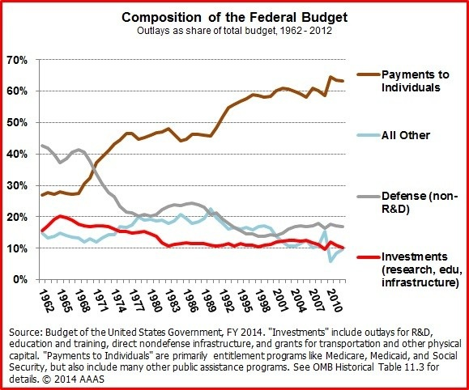
Broader Challenge: Shrinking Discretionary Federal Budget
Notes:
Major intervention program initiated by Ray Landis of Cal State LA with support from ARCO foundation back in the late 1980’s.
Various studies were done on interventions to create “better prepared” students, but this line of research was diminished by Sheila Tobias “They’re not Dumb they’re Different” (1990) and Seyour and Hewitt’s “Talking about Leaving” (1997) which led to a greater focus on understanding students a focus on their learning.
The focus on education systems is seen in the work of UW’s CAEE, NAE’s CASEE and most recently in BHEF’s dynamical systems model.

Slide 14
Teaching, Learning & Assessment
Innovations in Engineering Education
Experiential Learning
  Internships/Contests/Service/Venturing/Clinics
Inductive Learning
  PBL, Inquiry, Case-based, JIT, etc.
Design before fundamentals
  Real engineering, real early
Deployment of education research
Concept Tests and Authentic Assessments
Note overlaps in the elements above

Slide 15
Curriculum, Laboratories & Ed Tech
AWARENESS: Pre-college and first year overview courses suitable for non-majors
Engineering as design and as distinct from science (Pertrosky, PRISM, 12/2009)
Engineering as an integrator and realization of SMT concepts (NAE, 2009)
Engineering as public service

Slide 16
Engaging Practice
Multi-year, Vertically Integrated & Hands On
-- See research on value of
Tying coursework to personal experience (Science 4 Dec 2009 p1410)
Providing contextual and integrative activities (Cambridge-MIT Institute, 2007)
Inculcating a “systems” perspective (Grasso et al.)

Slide 17
Skills Building
Multi-dimensional Professionals
Technical skills
Communication skills
Social skills
Global awareness
Intercultural competence (national, ethnic, religious, etc.)

Slide 18

Summer 2011, Prism
Notes:
ASEE surveyed engineering deans across the country about “their hottest, most innovative, and most exciting courses.” The result was published in the Summer 2011 issue of ASEE’s general interest magazine Prism.

Slide 19
Key Themes
Context-driven
Hands-on, Minds-on, and Project-based
Enhance student’s “professional” skills
  Oral & Written Communications skills
  Teaming skills
  Leadership skills
Tied to student’s desires to help others
Highly engaged instructors
Interdisciplinary topics
Frequently, but not exclusively, introductory

Slide 20


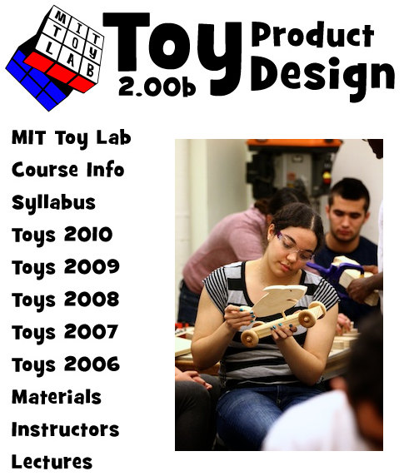
MIT Toy Product Design
Hands-on project-based design course
Introduction to the product design process
Students work in teams of 5-6 members
Students work closely with a local sponsor, an elementary school, and experienced mentors
At the end of the course, students present their toy products at the Playsentations

Slide 21

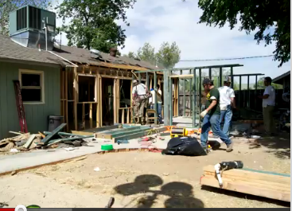
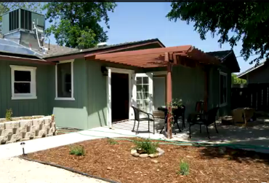
CalPoly PolyHouse
Project management class
Demolish and renovate a house to serve the needs of an elderly disabled and financially disadvantaged person during 2 weekends
Students raise over $100,000 in donations of cash, building materials and other assistance
Students deal with limited time, tight budget, and variable weather
Students find the hands-on experience both challenging and fulfilling
PolyHouse attracts students from various disciplines

Slide 22

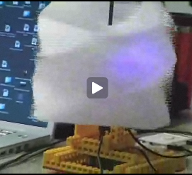
Creative Process
Co-taught by engineering, art & design, architecture, dance and music faculty
Student work on 4 mini-projects and a large final project
Projects encompass sound, motion, images, and objects
Project management class
A key lesson is that creativity is a process often accompanied by failure

Slide 23
Challenges in Sustaining Innovations in
Engineering Education
Achieving Institutionalization
Linking education to practice
Recognizing global commonalities
Notes:
Rare can an innovation be institutionalized without further investment. An even bigger challenge is a faculty culture that does not value adoption of other’s innovations.
On-campus innovatiosns often appear disconnected from engineering practice and so the search continues for NEW innovations.
We frequently frame our task as one of national competitiveness, but there are some issues that are similar around the globe and collaboration would make more sense at least in developing solution strategies (and then competing on implementation).

Slide 24
Instructors
The “Engineer of 2020” should be prepared by the faculty of 2010
Model core skills and competencies
Able to link research to practice
Possess real-world experience
Prepared to promote learning

Slide 25

Enhance Student Learning by Empowering Faculty
Report envisioned more effective faculty able to achieve significant and sustained enhancements to student learning

Slide 26
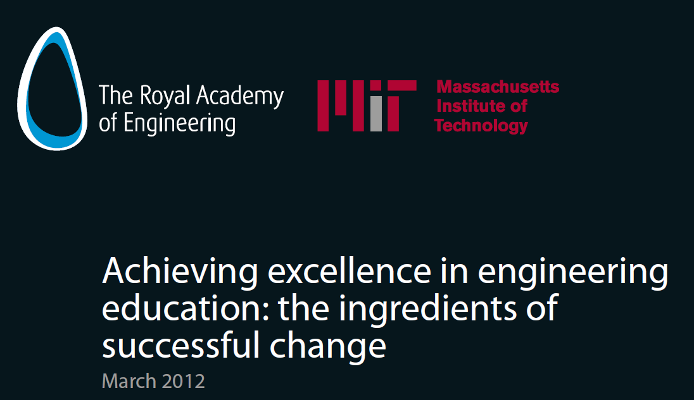
Key Enablers
Change is driven by acknowledged need
Innovation must be embedded within core curriculum {and other parts of system}
Sustained change depends on engaging a cross-section of faculty and administrators
Notes:
INNOVATION WITH IMPACT
Engage engineering faculty and administrators, provide for their scholarly development in education, and promote their cross–campus collaboration.
Educational programs must be more engaging, relevant, and welcoming to a broad array of students
Value the scholarship of teaching and learning, as well as educational innovation and provide resources for their pursuit by faculty
Assess student, faculty, institutional, and community-wide learning and progress.
ACHIEVING EXCELLENCE IN ENGINEERING EDUCATION
Successful widespread changes are usually triggered by significant threats to the market position of the department/school
Successful change is associated with the extent to which the change is embedded into a coherent and interconnected curriculum
Successful changes are those that had taken a department-wide approach to reform and the role of the department head is key
Resilient and persistent change are those that involve a cross-section of faculty in delivery of the new program , have a well-disseminated impact evaluation , and an on-going focus on educational innovation and reinvention.

Slide 27
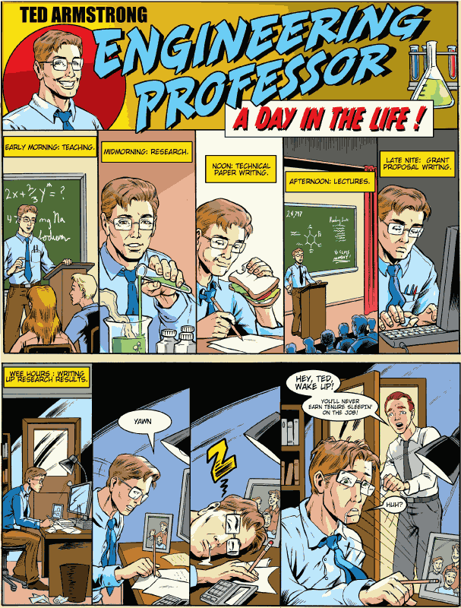
Jan 2007
ASEE Prism
cover story:
Ted Armstrong,
Engineering
Professor –
A Day in the Life
Note that his
family exists
only within
the photo; and
what about child and
elder care?

Slide 28
What Resources to Survive and Thrive?
PEOPLE:
  Use of mentors/role models?
  Other?
IDEAS:
  Use of more efficient and effective teaching/research/service strategies?
  Other?
TOOLS:
  Use of technologies?
  Other?

Slide 29
Learners
  Challenges for engineering education:
Declining Degree Production
Declining Interest

Slide 30
Declining Number of Students

Slide 31
Percentage of US BS Degrees by Group

Slide 32
BS degrees in engineering as % of all BS degrees
by U.S. ethnic group
9.0
5.0
4.0
3.0
2.0

Slide 33
Cyclic nature of degrees.
PSYCH
& SOC
ENG
BIO
& AG
MATH & CS
EARTH
& PHYS
SCI
NSF 07-307 Table 6
Notes:
NSF 07-307 – Table 6
The only consistent decline is in Earth and Physical Science, all others are sinusoidal
Math/CS and Engineering appear to be having the means increase.

Slide 34
HS Students Plans for College

Slide 35
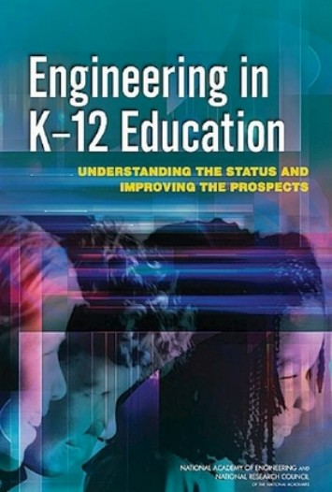
Next Generation Science Standards inclusion of
“engineering” provides an opportunity to build early awareness, interest, and commitment

Slide 36
Future K-12 Actions
Enhance the instructional capacity of teachers.
Enhance the ability of administrators to foster environments that support learning and achievement.
SOURCE: NRC Report on Successful STEM Education
Notes:
Fourth, to improve teaching and learning in the STEM disciplines, districts need to enhance
the capacity of K-12 teachers. STEM teachers should have a deep knowledge of their
subject matter and “an understanding of how students’ learning develops in that field, the kinds of
misconceptions students may develop, and strategies for addressing students’ evolving needs.”82
Fifth, districts should provide instructional leaders with professional development
that helps them to create the school conditions that appear to support student
achievement (see section above on school conditions). School leaders should be held accountable
for creating school contexts that are conducive to learning in STEM.

Slide 37
Success Depends Upon Re-engineering Engineering Education
ACADEME
DIVERSE
GLOBALLY
COMPETITIVE
21ST CENTURY
ENGINEERING
WORKFORCE
INDUSTRY
INCREASE
KNOWLEDGE
BUILD
R & D
CAPACITY
SHARE
KNOWLEDGE
TRANSFORM
ENGINEERING
EDUCATION
GOVERNMENT
BUILD
COMMUNITY
PROFESSIONAL
SOCIETIES

