Slide 1
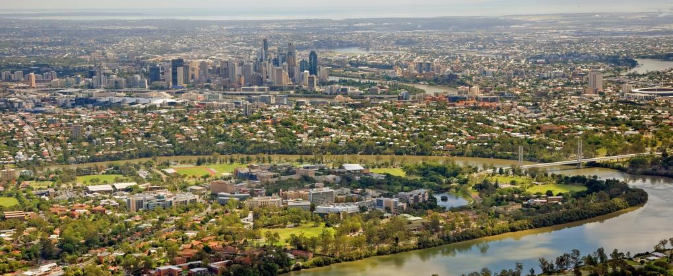
Faculty of Engineering, Architecture and Information Technology
Professor Graham Schaffer
Executive Dean

Slide 2
Brisbane

Slide 3
A LEADING UNIVERSITY
Established in 1909
More than 400 degree programs
More than 46,000 students
More than 11,000 international students from 134 countries
More than 12,000 postgraduate students
More than 4,500 research higher degree students
More than 10,500 PhD graduates
More than 7,000 staff
More than 210,000 Alumni in 160 countries
More than $1.6 billion turnover
Notes:
UQ was established in 1909 and currently offers more than 400 degree programs.
UQ’s 46,000-strong student community includes over 11,000 international students from 134 countries.
Our student cohort is compromised of over 12,000 postgraduate students.
UQ currently has almost 4600 Research Higher Degree students
UQ has graduated over 10,500 PhD’s.
We have over 7,000 professional and academic staff.
Over the past 100 years, UQ has produced more than 210,000 graduates who are now dispersed across 160 countries.

Slide 4
A TOP 100 UNIVERSITY
Ranking body | UQ’s 2013 rank
 | World | Australia
QS World University Rankings | 43 | 4
Times Higher Education’s World University Rankings | 63 | 3
Academic Rankings of World Universities – Shanghai Jiao Tong University | 85 | 3
National Taiwan University – Performance Ranking of Scientific Papers | 67 | 3
QS World University Subject Rankings – Chemical Engineering | 12 | 1
The Economist – ranking of full-time MBA programs | 14 | 1
Notes:
Outstanding results across international rankings bolster UQ’s ability to attract the best and brightest students – providing them with the inspiration and support to achieve their aspirations and fulfil their potential.
Measured through a combination of key global university rankings – The Times Higher Education, Academic Ranking of World Universities and QS World University – UQ is currently ranked as one of the top 100 universities worldwide.

Slide 5
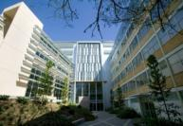
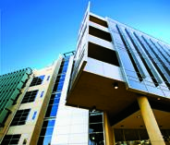
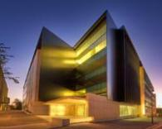
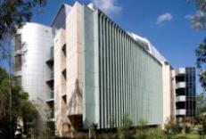
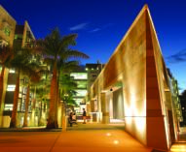
A COMPREHENSIVE UNIVERSITY
Business, Economics and Law
Engineering, Architecture and Information Technology
Health and Behavioural Sciences
Humanities and Social Sciences
Medicine and Biomedical Sciences
Science
Australian Institute for Bioengineering and Nanotechnology
Sustainable Minerals Institute
Global Change Institute
Institute for Molecular Bioscience
Institute for Social Science Research
Queensland Brain Institute
Agriculture and Food Innovation
UQ Diamantina Institute
Six Faculties
Eight Institutes
Notes:
UQ is a comprehensive university and is made up of six faculties:
Business, Economics and Law
Engineering, Architecture and Information Technology
Health and Behavioural Sciences
Humanities and Social Sciences
Medicine and Biomedical Sciences
Science
UQ’s eight internationally significant research institutes are drawcards for an ever-expanding community of scientists, researchers and commercialisation experts.
Australian Institute for Bioengineering and Nanotechnology
Global Change Institute
Institute for Molecular Bioscience
Institute for Social Science Research
Queensland Brain Institute
Queensland Alliance for Agriculture and Food Innovation
Sustainable Minerals Institute
UQ Diamantina Institute in the Translational Research Institute

Slide 6
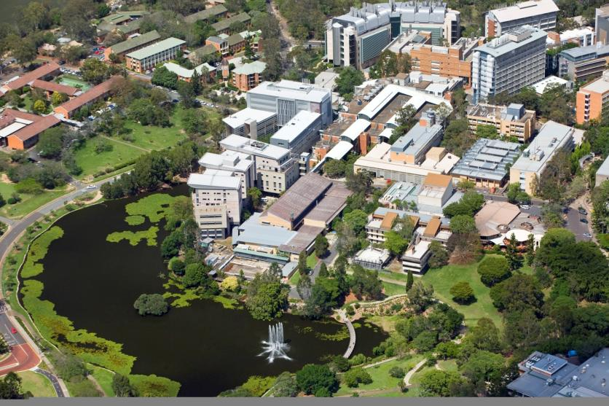
Engineering at UQ
Faculty of Engineering, Architecture and IT Australian Institute for Bioengineering and Nanotechnology Sustainable Minerals Institute

Slide 7
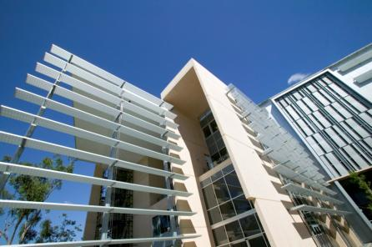
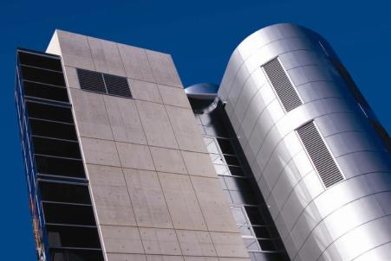
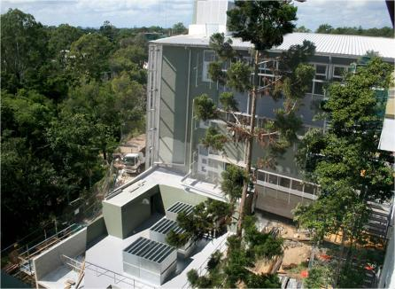
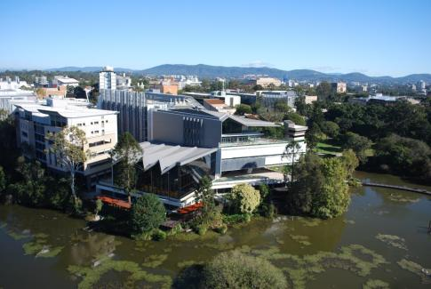
$300 million building program

Slide 8
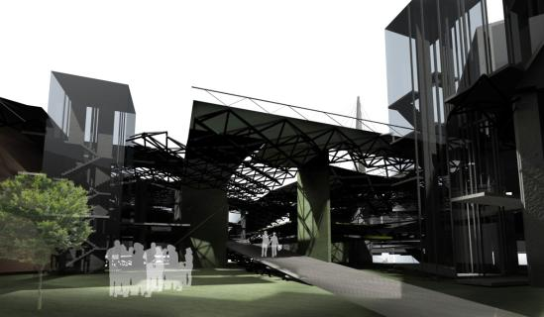
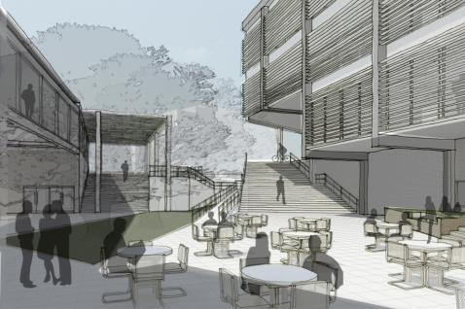
Engineering, Architecture, IT
School of Chemical Engineering
School of Civil Engineering
School of Architecture
Advanced Water Management Centre
School of Mechanical and Mining Engineering
School of Information Technology and Electrical Engineering

Slide 9
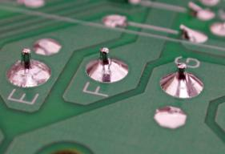
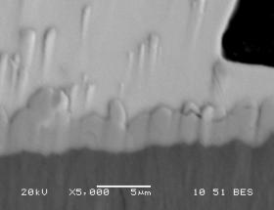
Engineering, Architecture, IT
Home to over 500 staff
150 academic staff
190 research staff
180 professional staff
Provides education for
4,500 undergraduate students
600 PhD students
400 postgraduate coursework students
Approaching 900 research engineers
Annual revenue of $162 million
Research grant income of $45 million
Research budget of $70 million
Ni modified Pb-free solders for microelectronics

Slide 10
Vision
Purpose
We will be a leading global university in engineering, architecture and information technology.
To advance knowledge, develop solutions and educate people who move society forward.
Values
Excellence
Opportunity
Courage
Honesty
Respect
We act with integrity and uphold the highest ethical standards
We welcome and embrace diversity in our community.
We create an inclusive and supportive university community.
We support intellectual freedom and expect intellectual courage.
We strive for excellence to benefit our communities.
Collegial
Collaborative
Pioneering
Professional
Culture
We are passionate intellectual leaders who are focussed on the future, the frontiers of knowledge and the development of our staff and our students.
We are inclusive, provide opportunities for staff development and are supportive of diversity in staff, students and ideas.
We are active partners with global universities, industry, government, alumni and each other in ways which are relevant, flexible, mutually valuable and sustainable.
We are professional in our engagement with all our stakeholders and are focussed on service and safety.
Characteristics
Discovery
Engagement
Learning
We will be distinguished by our curriculum, the opportunities and choices we offer, our high performing students, the learning environment and a social learning experience that is rigorous, interesting, internationalised, research led and provides a foundation for life long learning.
We will be distinguished by research of the highest quality that is focussed on critical enquiry and creative solutions to the big questions and that is used by industry, government and other scholars.
We will be distinguished by partnerships that are developed for mutual benefit with all our stakeholders, including business, government, alumni, philanthropists and volunteer leaders.
Strategies
Student Experience
Research Leadership
Enrich the student experience through the use of pedagogies based on learning communities and active student engagement that supports a broad suite of learning opportunities and experiences.
Develop mechanisms to widely integrate research into teaching, including research-led teaching.
Implement a plan for program based, contextualised professional development for teaching staff.
Recognise and reward teaching excellence and encourage the scholarship of teaching.
Attract and retain high performing people whose research addresses significant problems and support them through investment in facilities, laboratories and a career development program.
Develop capacity in critical competencies including technically grounded design and computational engineering that underpin research of globally relevant, wicked problems.
Grow the PhD program and provide a learning experience that fosters the development of independent research skills.
Recognise and reward research outcomes that have had a demonstrated beneficial impact.
Build global connectedness and relevance through engagement with alumni, government, business and research partners.

Slide 11
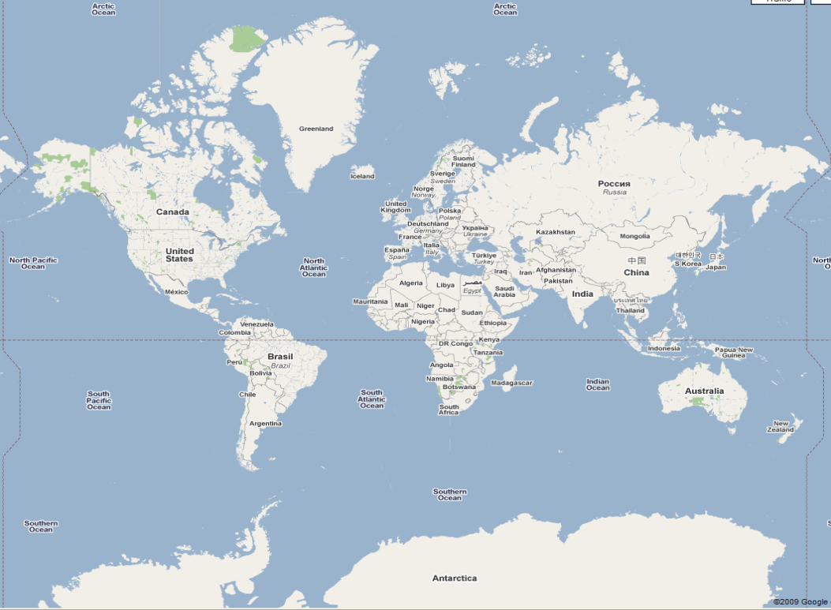
Global Opportunities - Students

Slide 12
Global Opportunities - Staff

Slide 13
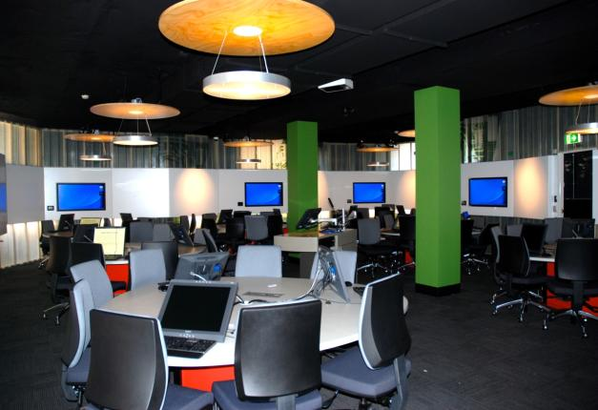
Undergraduate Programs
Chemical
Chemical & Biological
Chemical & Environmental
Chemical & Materials
Chemical & Metallurgical
Civil
Civil & Environmental
Civil & Geotechnical
Electrical
Electrical & Biomedical
Electrical & Computer
Mechanical
Mechanical & Aerospace
Mechanical & Materials
Mechatronic
Mining
Mining & Geotechnical
Software
Architectural Design
(Master of Architecture)
Computer Science
Information Technology
Multimedia Design

Slide 14
Engineering Structure
Depth
Year 5.5
BE, B...
ME
Year 5
BE, BSc
BE
Year 4
Breadth
Year 3
Year 2
Year 1

Slide 15
BE Structure
Major
Major with Minor
Dual or Extended Major
BE/BSc Dual (#80)
Other BE Duals (#88)
#50
#50
#60
#62 (BE part)
#52 to #56 (BE part)
Major only
#14
#10
#32 to #36 (Other degree)
#4
#4
#18 (BSc part)

Slide 16
Drivers for Change
How do we best educate engineers for an increasingly globalised world?
How do we provide sufficient specialisation and in-depth knowledge while simultaneously providing opportunities for broadening?
How do we incorporate a research experience into the undergraduate curriculum?
How do we provide alternative pathways and multiple exit points for a divergent student body?
How do we enrich the engineering education experience while adapting to increasing enrolments and decreasing staff/student ratios?

Slide 17
1st Year Structure
MATH1051
MATH1052
ENGG1100 (Design/Build/Test)
ENGG1200 (Model/Design/Build/Test)
Electronics and Electrical Systems
Mechanics
Thermodynamics
Biology
Chemistry
Physics
Computer Science
Earth Science
Core #8 required
Engineering Science #2 required #4 encouraged
Other Science Remainder #

Slide 18
Revise the Pedagogy

Slide 19
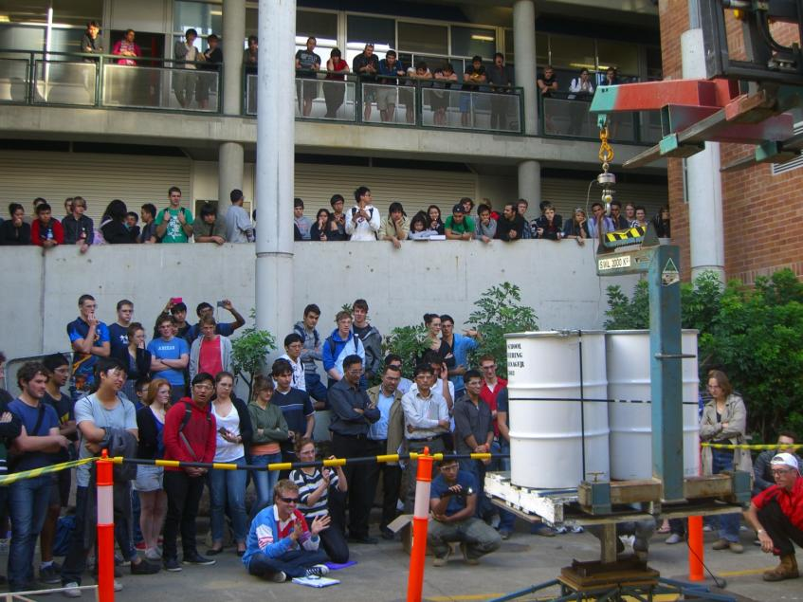
Revise the Pedagogy

Slide 20
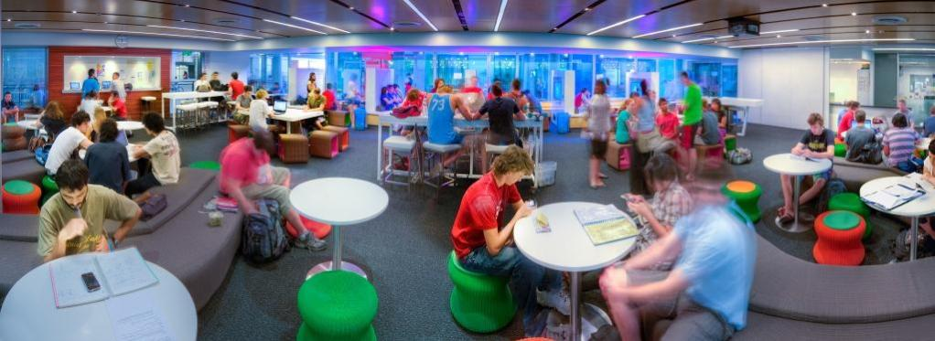
Scholarship of Teaching
Radical transformation: re-imagining engineering education through flipping the classroom in a global learning partnership.
Balancing curriculum processes and content in a project centred curriculum - In pursuit of graduate attributes.
Identifying threshold concepts: Case study of an open catchment hydraulics course.
Scoping metalearning opportunity in the first three years of engineering

Slide 21
Massive Open Online Courses (MOOCs)

Slide 22
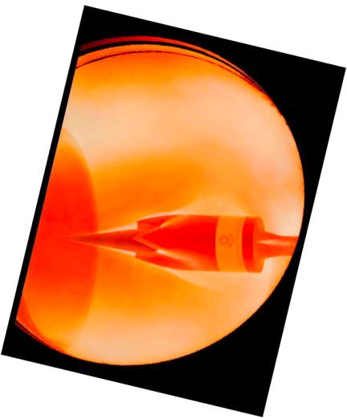
Research Excellence
Excellence for Research in Australia (ERA)
5. Engineering
5: Engineering – Chemical, Environmental,
Materials
5: Technology – Nanotechnology,
Environmental Biotechnology
5: Information Systems
4: Architecture, Mechanical Engineering,
Resources & Metallurgy

Slide 23
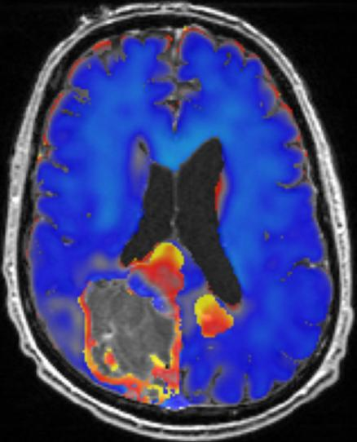
Research Strengths
Aboriginal Environments
Architecture Theory, Criticism & History
Biomedical Engineering
Biological Engineering
Energy and Power
Hypersonics
Intelligent Systems
Modelling & Simulation of Complex Systems
Materials Engineering
Mining and Minerals Technology
Water Engineering & Management

Slide 24
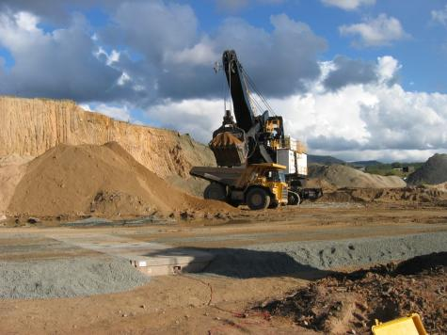
Research Commercialisation
55 patent applications and 7 start-up companies in the last 5 years.
Spin-off from PhD: Transient Blocking Unit, based on a patent for an in-line surge protection device for communications equipment, now marketed by Bourns, Inc.
Collaboration with CRC 1: A spin-off from the CRC for Signal Sensing and Information Processing, Groundprobe Pty Ltd serves more than 60 mining companies, employs about 160 people and has offices in Australia, Chile, South Africa and China.
Collaboration with CRC 2: From the CRC
Mining, the Trackshield Collision Control
System for electric rope shovels marked by
P&H MinePro Services.
Licence of Patent: A method for the
correction of distortion in an MRI machine,
licensed to two of the world’s largest MRI
manufacturers and has been incorporated
into nearly all of their machines.

Slide 25
Industry Engagement

Slide 26
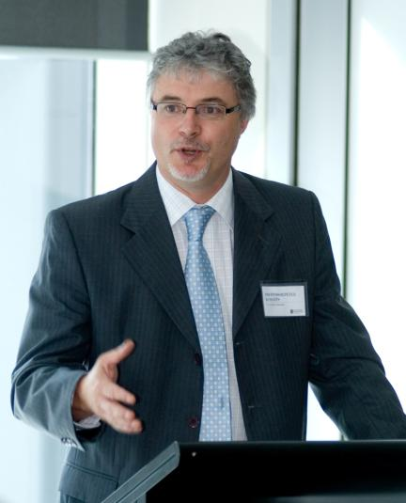
Externally Funded Chairs
Xstrata Chair of Metallurgical Engineering
BMA Chair of Mining Engineering
BMA Chair of Minerals Processing
Golder Chair of Geomechanics
Geotechnical Engineering Centre Chair
P&H Chair of Mechanical Engineering
API/Powerlink Chair in Electricity Transmission
Main Roads Chair in Civil Engineering
Transport Futures Chair
DSTO Chair in Hypersonics
Remondis Chair in Waste Management

Slide 27
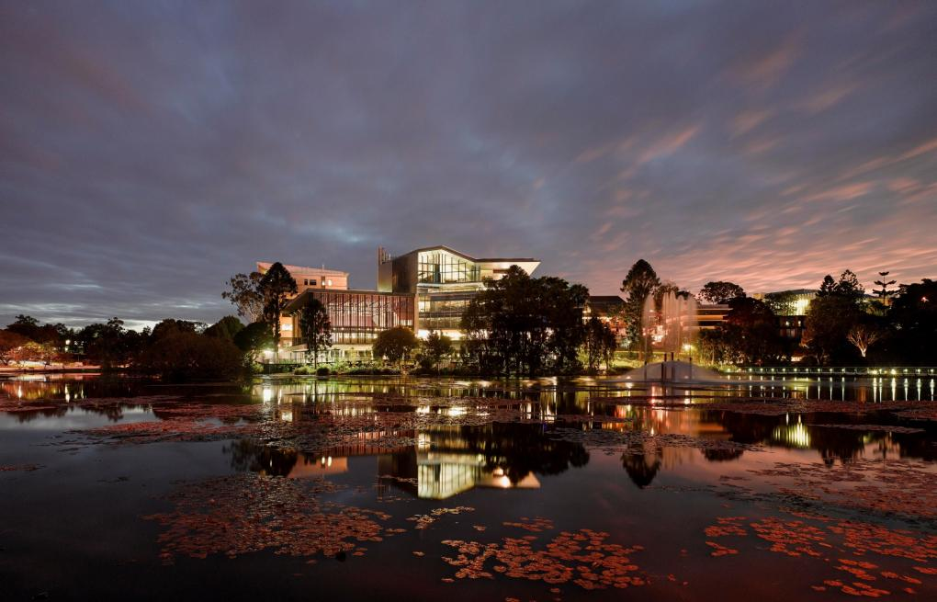
Thank You

