Slide 1
The Lean Mindset
Ask the Right Questions

Slide 2
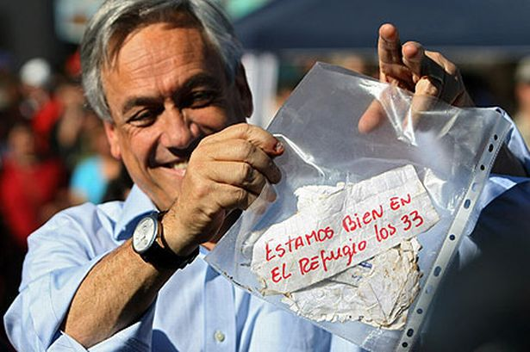
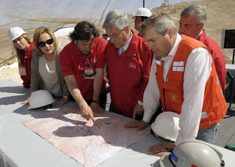
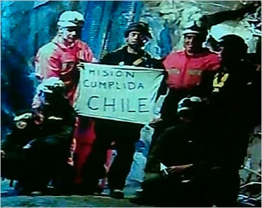
Against All Odds
Aug 5, 2010
The San José Mine Collapsed
The Rescue Team
Sponsor: President Sebastián Piñera
Leader: André Sougarret
– Codelco Mine Manager
The Leadership Team:
32 Handpicked Codelco Mangers
IF the miners had survived and followed protocol, they would be in a ‘refuge’ area with enough food for 10 people
for 2 days and water for a month.
The Rescue Effort
Success!
October 13 Headline:
All 33 Chilean Miners Rescued
in a Flawless Operation
Step 1 – Drill to the refuge area
Many quick probes to learn how
to drill accurately. [17 days]
Step 2 – Rescue the miners
Try Plans A, B, and C to see which is fastest. [52 days – Plan B wins]
Leadership Lessons from the Cilean Mine Rescue, by Rashid, Edmondson, and Leonard, Harvard Business Review, 8/2013

Slide 3
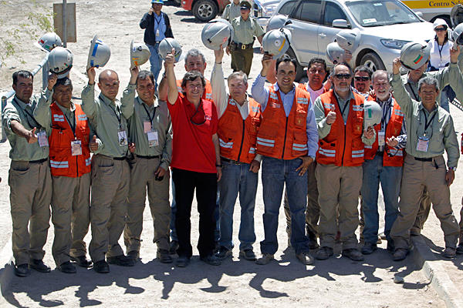
Four Lessons
The Power of Challenge
  Not Too Easy, Not Too Hard
The Need for Expertise
  And Expert Leaders
“The best moments [in our lives] usually occur when a person’s body or mind is stretched to its limits in a voluntary effort to accomplish something difficult and worthwhile.”
There are no instant experts in chess…
We would estimate, very roughly, that a [chess] master has spent perhaps 10,000 to 50,000 hours staring at chess positions.
Mihaly Csikszentmihalyi - 1991
Herbert Simon and William Chase - 1973
Think  Try  Learn 
  Dynamically Intertwined Execution and Adaptation
It’s Not About Money
  Energized Workers  Delighted Customers  Sustainable Profits
In today’s world of apps and platforms, the boundary between developing and deploying software has largely disappeared. Continuous Delivery is now standard engineering practice for the web, cloud, mobile and Saas space.
The energy fueled by being part of
a winning team. The pride of a
job well done.

Slide 4

Lesson 1: The Power of Challenge
Remember times when:
  You are deeply engaged
  Distractions disappear
  Time evaporates
  This is called FLOW.
Anxiety
Challenges
Flow Channel
Boredom
Mihaly Csikszentmihalyi
(me-high chick-sent-me-high-ee)
Skills

Slide 5
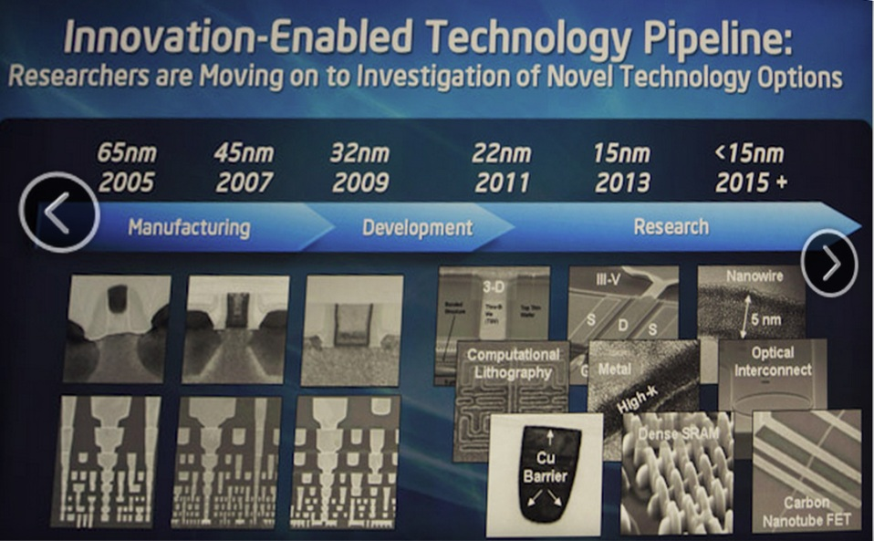
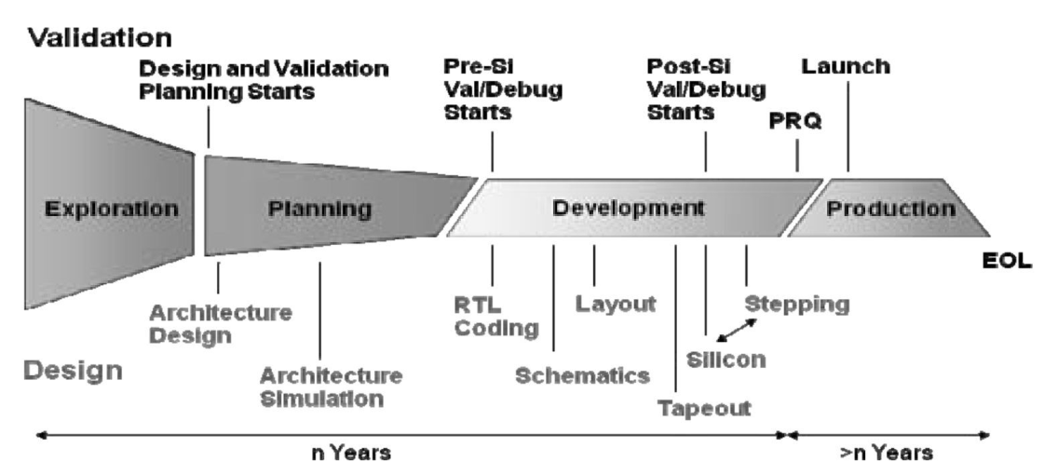
Thriving on Challenge
Challenge: Moore’s Law
At Intel, every department is involved in Moore’s Law.
Including PDE.
(Product Development Engineering)
1
2
3
From First Silicon to PRQ
(Product Readiness Qualification)
Timeline
2007-2008: Early Agile
2009-2010: Advanced Agile
2011-2012: Beyond Agile
Post-silicon Validation Challenges, by Keshava, Hakim, & Prudvi (Intel), presented at DAC ’10, Anaheim, 2010

Slide 6
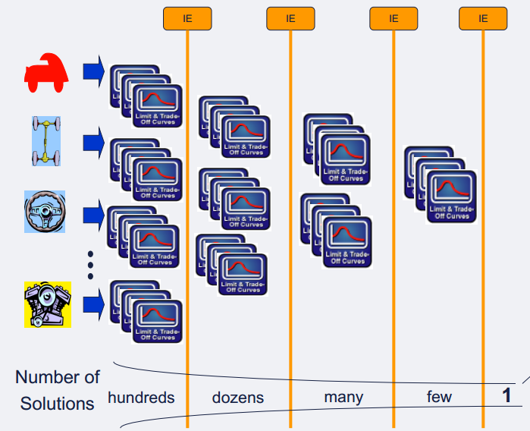
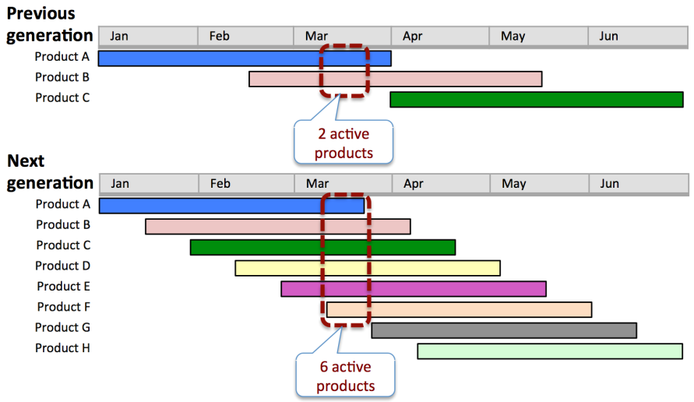
Triple Productivity in 18 Months
20011 – 2012: Beyond Agile
Lean Product Development
Moore’s Law required:
3X More Validation Cycles
Same Funding and Time
18 months to figure it out.
3X Working Group:
Translate 3X to Specific Targets
Solution sets converge through a series of Integrating Events (IE’s) before detailed design begins.
www.targetedconvergence.com

Slide 7
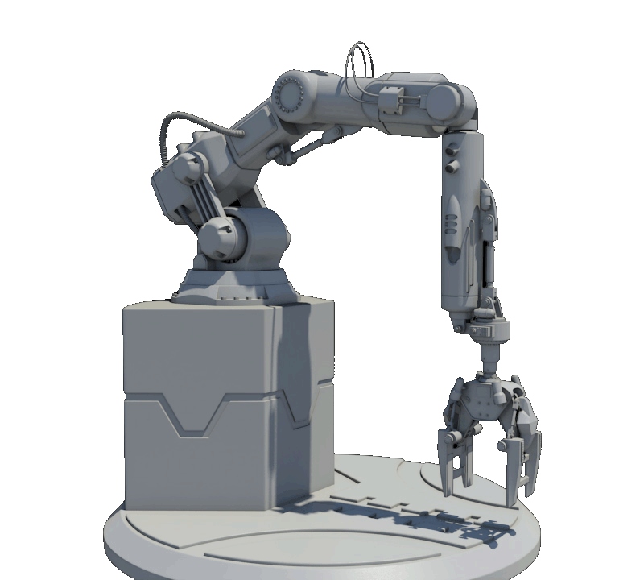
Have You Tested It?
Goal: Every two weeks, over a 48 hour weekend, software will be validated by placing 55,000 units in test sockets.
Feasibility: Robot specs show it is capable of doing this.
Coach: Have you tested it?
Team: No…but –
Team decided to test 1500 parts.
Robot broke down after 80….
It took a year of improvements
for the robot to work reliably at
the needed volume and speed.

Slide 8
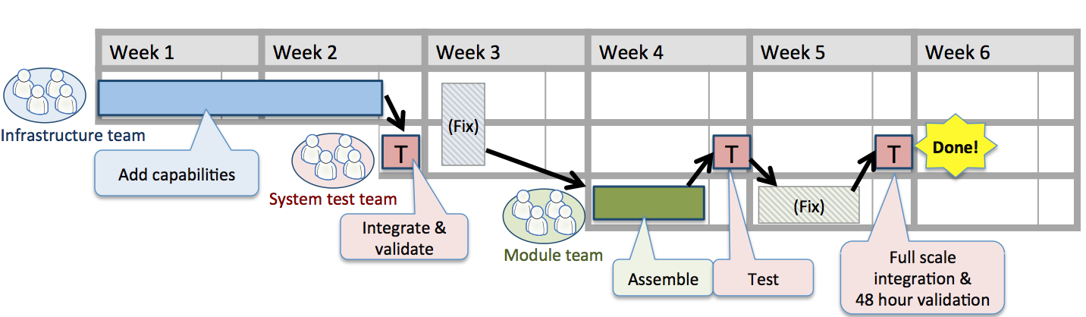
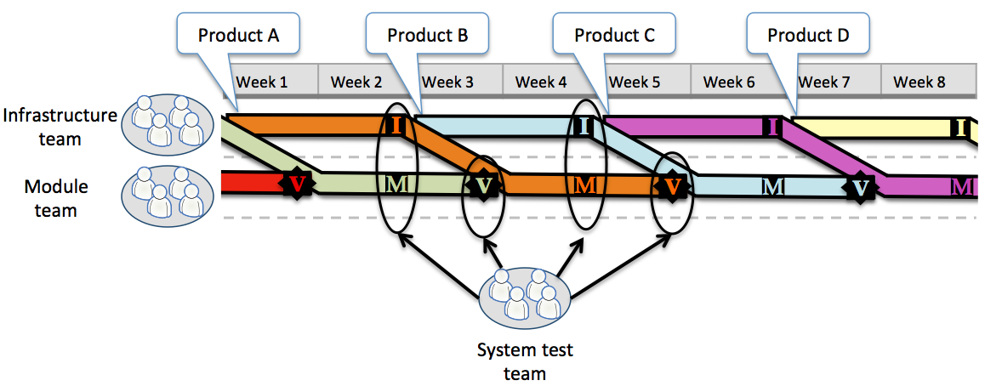

Slide 9
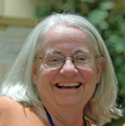
Lesson 2: The Need for Expertise
Decades of successful software engineering without detailed specifications, a backlog of stories, or long list of features and functions.
Requirements for a Process Control System
It has to make good product.
It MUST be on time.
Operators must find it convenient to use.
It will be maintained by the plant engineer.
It should contain the latest technology.
Everything else is design!

Slide 10
Where Does Expertise
Come From?
10 Years / 10,000 hours of Deliberate Practice
  Identify a specific skill that needs improvement.
  Devise (or learn from a teacher) a focused exercise:
  – designed to improve the skill.
  Practice repeatedly.
  Obtain immediate feedback:
  – adjust accordingly.
  Focus on pushing the limits:
  – expect repeated failures.
  Practice regularly & intensely:
  – perhaps three hours a day.
Athletes
Musicians
Software Developers
Doctors

Slide 11
The Four Elements of
Deliberate Practice
Coach
Challenge
Feedback
Progress

Slide 12
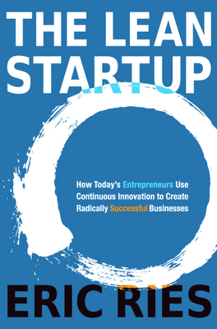
Lesson 3: Think  Try  Learn 
Agile Development
Lean Startup
Product Owner
Entrepreneur
Product Vision
Product-Market Fit
Product Roadmap
Business Model
“On-Site Customer”
“Get Out Of The Building”
Release Plan
Minimal Viable Product
Backlog
“To Learn” List
Iteration
Build-Measure-Learn Loop
User Story
Hypothesis
Continuous Integration
Continuous Deployment
Adapted from chart by Joshua Kerievsky, Industrial Logic, 8/2011
Iteration Review
Persevere or Pivot
https://elearning.industriallogic.com/gh/submit?Action=PageAction&album=blog2009&path=blog2009/2011/agileVsLeanStartup&devLanguage=Java
Acceptance Test
Split Test
Definition of Done
Validated Learning
Customer Feedback
Actionable Metrics

Slide 13

Software Engineering Today
Design
Model
Hypothesis
SBE
Wireframes
Source
Code & Tests
Environment
& Application
Configuration Scripts
VERSION CONTROL
Self-Service
Deployments
User Acceptance
Configure Environment
Deploy Binaries
Smoke Test
Manual Testing
Testers
Develop
Design
Code & Script
Unit Test
Refactor
Commit
Compile
Commit Tests
Assembly
Code Analysis
Accept
Configure Environment
Deploy Binaries
Smoke Test
Run Acceptance Tests
Capacity/Security
Configure Environment
Deploy Binaries
Smoke Test
Run Capacity Tests
Testers
BINARIS
Reports
Metadata
Production
Configure Environment
Deploy Binaries
Smoke Test
Reports
Metadata
Reports
Metadata
BINARIS
Reports
Metadata
BINARIS
Operations
Push-Button
Releases
ARTIFACT REPOSITORY

Slide 14


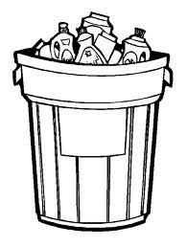
How Spotify Builds Products
By Henrik Kniberg
Product
idea!
Worth prototyping?
Mgmt
Yes!
Think It
Build it
Tech
Prod Def
Squad
Prod Def
Prod
Narrative
Metrics
Mgmt
Mgmt
Narrative
Metrics
Design
Create a
Think It
squad
Write narrative
Define metrics
Build prototype
Worth building?
Yes!
Expand to a Build It squad
Internal releases
MVP
MVP good enough for real users?
Yes!
x
Not yet
Never
Not yet
Never
x
x
Tweak it
Ship it
Prod Def
Mgmt
Squad
Narrative
Metrics
MVP
Continuously tweak,
A/B test,
measure
Release to 100% of users
Yes!
Good enough for full rollout?
Measure, learn, adapt
A/B test
Release MVP to few % of users
<
Not yet
Never
Copyright©2013 Henrik Kniberg

Slide 15
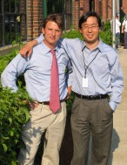

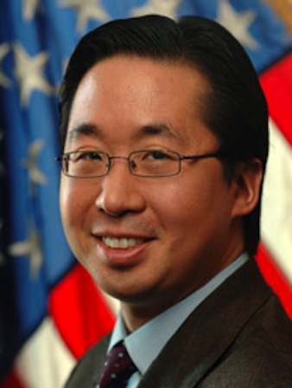
Lesson 4: It’s Not About Money
Todd Park
Harvard Graduate (Economics)
Booz Allen Hamilton Consultant (Managed Care)
Athenahealth (1997)
  Maternity Clinic (Opps…)
  Health Care Records (Got it right!)
  Very successful IPO (2007)
Retirement .........
Act II
US Health and Human Services CTO (2009)
  Purpose: Improve the health, safety, and well-being of America
  The Job: Bring Entrepreneurial Mindset to HHS
  Reluctance: A Step Backward in lifestyle and compensation
  No Surprise: Lots of dedicated workers in the government
  The Surprise: The amazing databases of HHS

Slide 16

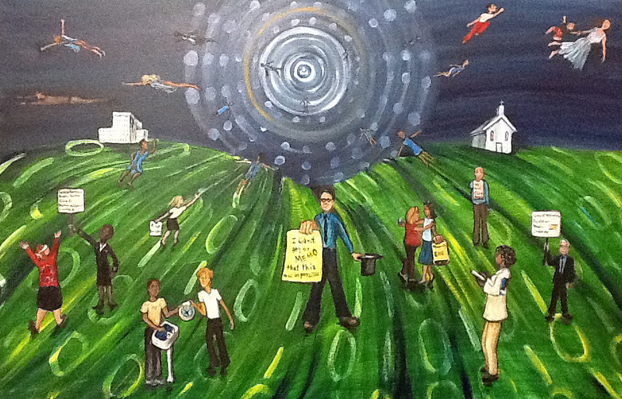
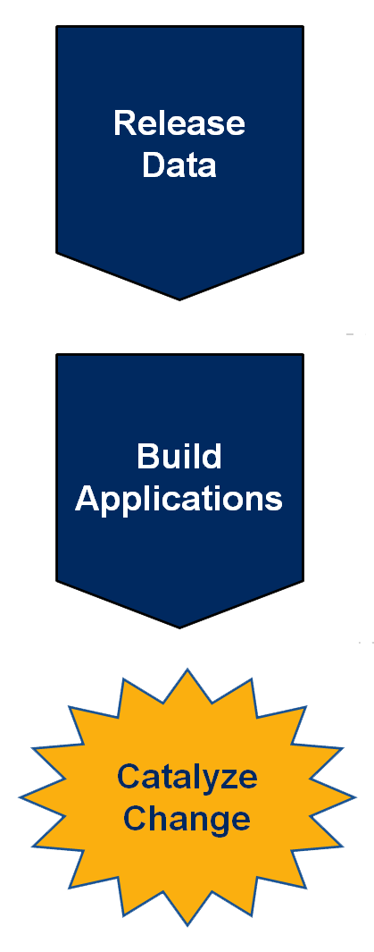

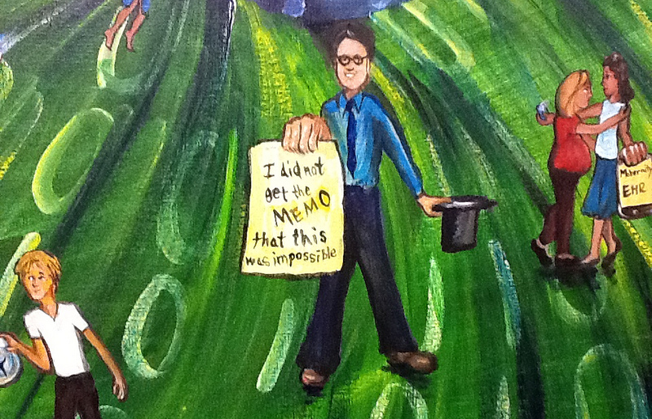
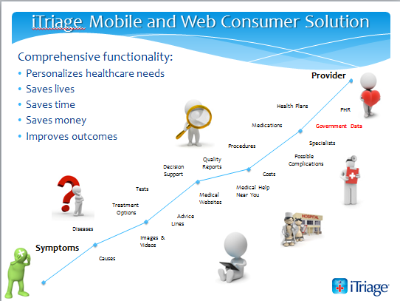
Data Liberation
2010
2011
2012
Artist Regina Holliday
Todd Park – Federal Government CTO
Give people permission and tools to pursue their passion.

Slide 17
The Satisfaction of a Job Well Done
Proud of our purpose
Proud of the way we work
Proud of the products and services we deliver
Proud of the impact our work has on the world

Slide 18
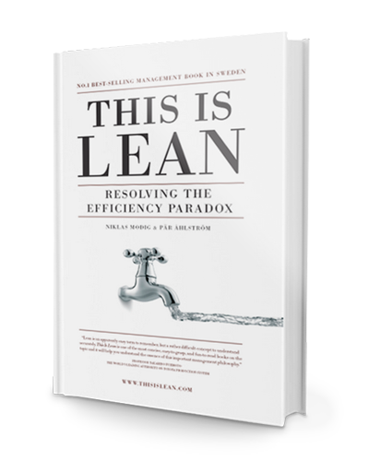

Lesson 5: It’s About FLOW
High
Utilization
Traffic
Jam!
Resource Efficiency
Genuine Efficiency
PULL
This is Lean: Resolving the Efficiency Paradox By Niklas Modig,
Par Ahlstrom
W A S T E
X X X X X
Low
Utilization
Slow
Delivery
Fast
Delivery
Flow Efficiency

Slide 19

How can we get done faster?
Ericsson Networks
The past was not good enough for the future.
Manage features, not projects.
Decouple releases from development.
Small, multi-discipline feature teams.
  Product and technical leadership.
  Autonomy and responsibility.
Component specialists were consultants
Central planning coordinates features
  One feature (~3 weeks) at a time
  Set date and allow content to vary
  Team worked with customer engineer
  to determine detailed scope
Results:
  Twice as fast
  Higher hit rate
  Significantly higher quality
  More engaged engineers
Mats Lindén

Slide 20
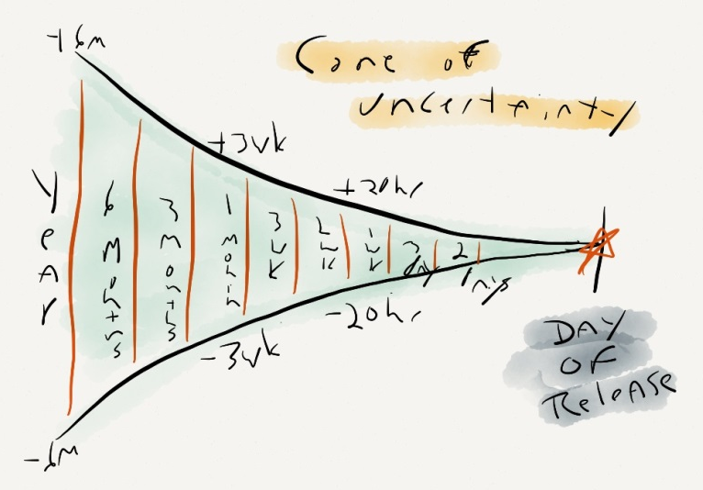
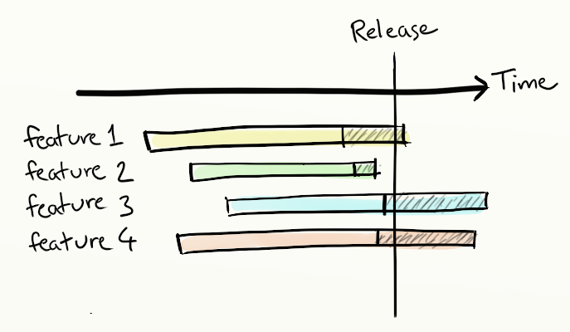
Why aren’t we predictable?
Ericsson Networks
The past was not good enough for the future.
Accept uncertainty and learn how to live with it.
Manage features, not projects.
Decouple releases from development.
Small, multi-discipline feature teams.
  Product and technical leadership.
  Autonomy and responsibility.
Reorganized management jobs
Central planning coordinates features
  Sets content and allow date to vary
Hendrik Esser

Slide 21
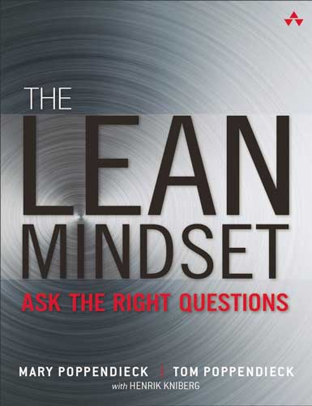
The Lean Mindset
Great Companies
  Start with Why?
Energized Workers
  The Power of Challenge
Delighted Customers
  Don’t Guess – Experiment!
Genuine Efficiency
  Flow Efficiency Over Resource Efficiency
Breakthrough Innovation
  Small, experienced, decision-empowered teams

Slide 22
Thank You!
More Information: www.poppendieck.com

